Slide 1

Expectimax, Utilities and MDPs
Read AIMA Chapter 16.1-16.3,
and AIMA Chapter 17.1-17.3,
and Sutton and Barto, Chapter 3
Slides courtesy of Dan Klein and Pieter Abbeel University of California, Berkeley

Slide 2
Uncertain Outcomes

Slide 3
Worst-Case vs. Average Case
max
min
10
10
9
100
Idea: Uncertain outcomes controlled by chance, not an adversary!
Notes:
At least 10, or otherwise just rather dead; or just 100, or otherwise rather dead; that’s yet something different than minimax or expectimax
Down arrows = min nodes
Circles = chance nodes.

Slide 4
Expectimax Search
Why wouldn’t we know what the result of an action will be?
Explicit randomness: rolling dice
Unpredictable opponents: the opponent isn’t optimal
Actions can fail: when moving a robot, wheels might slip
Values should now reflect average-case (expectimax) outcomes, not worst-case (minimax) outcomes
Expectimax search: compute the average score under optimal play
Max nodes as in minimax search
Chance nodes are like min nodes but the outcome is uncertain
Calculate their expected utilities
I.e. take weighted average (expectation) of children
Later, we’ll learn how to formalize the underlying uncertain-result problems as Markov Decision Processes
max
chance
10
10
4
10
5
9
7
100

Slide 5
Expectimax Pseudocode
def value(state):
if the state is a terminal state: return the state’s utility
if the next agent is MAX: return max-value(state)
if the next agent is EXP: return exp-value(state)
def max-value(state):
initialize v = -∞
for each successor of state:
v = max(v, value(successor))
return v
def exp-value(state):
initialize v = 0
for each successor of state:
p = probability(successor)
v += p * value(successor)
return v
Notes:
Max is just like before. Exp is the expectation of what will happen next.

Slide 6
Expectimax Pseudocode
def exp-value(state):
initialize v = 0
for each successor of state:
p = probability(successor)
v += p * value(successor)
return v
1/2
1/6
1/3
5
8
7
24
-12
v = (1/2) (8) + (1/3) (24) + (1/6) (-12) = 10

Slide 7
Expectimax Example
3
12
9
2
4
6
15
6
0
Notes:
Here imagine that all children are equally likely.
8 … 4 …. 7

Slide 8
Expectimax Pruning?
3
12
9
2
Notes:
In Minimax we were done, since 2 would always be less than 3.
Here the average of 3, 12 and 9 = 8.
Can the average be less than 2 on the middle node? YES!!! Much harder to prune.

Slide 9

Depth-Limited Expectimax
Estimate of true expectimax value (which would require a lot of work to compute)
400
300
…
…
492
362
…
Notes:
Let’s image they are actually random ghosts. 2 layers of random ghost actions.
At the actual end of the game, we have the score. But we can’t do that so we have to cut the process off.
So we need some way of evaluating the

Slide 10
Probabilities

Slide 11

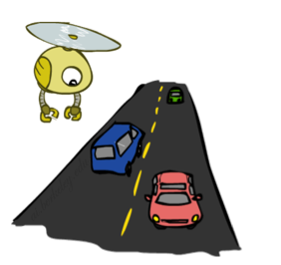
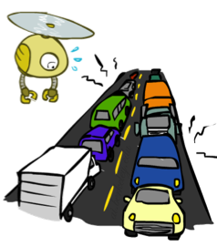
Probabilities
A random variable represents an event whose outcome is unknown
A probability distribution is an assignment of weights to outcomes
Example: Traffic on freeway
Random variable: T = whether there’s traffic
Outcomes: T in {none, light, heavy}
Distribution: P(T=none) = 0.25, P(T=light) = 0.50, P(T=heavy) = 0.25
Some laws of probability (more later):
Probabilities are always non-negative
Probabilities over all possible outcomes sum to one
As we get more evidence, probabilities may change:
P(T=heavy) = 0.25, P(T=heavy | Hour=8am) = 0.60
We’ll talk about methods for reasoning and updating probabilities later
0.25
0.50
0.25
Notes:
In general, we will be computing probabilities. As we get more evidence the probabilities will change. We will look at Probabilistic Inference later in this course.

Slide 12
Expectations
The expected value of a function of a random variable is the average, weighted by the probability distribution over outcomes
Example: How long to get to the airport?
Time:
20 min
30 min
60 min
+
+
35 min
x
x
x
Probability:
0.25
0.50
0.25

Slide 13
What Probabilities to Use?
In expectimax search, we have a probabilistic model of how the opponent (or environment) will behave in any state
Model could be a simple uniform distribution (roll a die)
Model could be sophisticated and require a great deal of computation
We have a chance node for any outcome out of our control: opponent or environment
The model might say that adversarial actions are likely!
For now, assume each chance node magically comes along with probabilities that specify the distribution over its outcomes
Having a probabilistic belief about another agent’s action does not mean that the agent is flipping any coins!
Notes:
Where do the probabilities come from? For today, they come from the probability fairy. They are given by the problem definition. Later we will look at how to compute them.

Slide 14
What are Probabilities?
Objectivist / frequentist answer:
Averages over repeated experiments
E.g. empirically estimating P(rain) from historical observation
Assertion about how future experiments will go (in the limit)
New evidence changes the reference class
Makes one think of inherently random events, like rolling dice
Subjectivist / Bayesian answer:
Degrees of belief about unobserved variables
E.g. an agent’s belief that it’s raining, given the temperature
E.g. agent’s belief how an opponent will behave, given the state
Often learn probabilities from past experiences (more later)
New evidence updates beliefs (more later)

Slide 15
Quiz: Informed Probabilities
Let’s say you know that your opponent is actually running a depth 2 minimax, using the result 80% of the time, and moving randomly otherwise
Question: What tree search should you use?
Answer: Expectimax!
To figure out EACH chance node’s probabilities, you have to run a simulation of your opponent
This kind of thing gets very slow very quickly
Even worse if you have to simulate your opponent simulating you…
… except for minimax, which has the nice property that it all collapses into one game tree
0.1 0.9
Notes:
…Except, what if your opponent simulates you? You can get into this crazy recursive trees. If you go too far down the computation then
That only really works out for minimax.

Slide 16
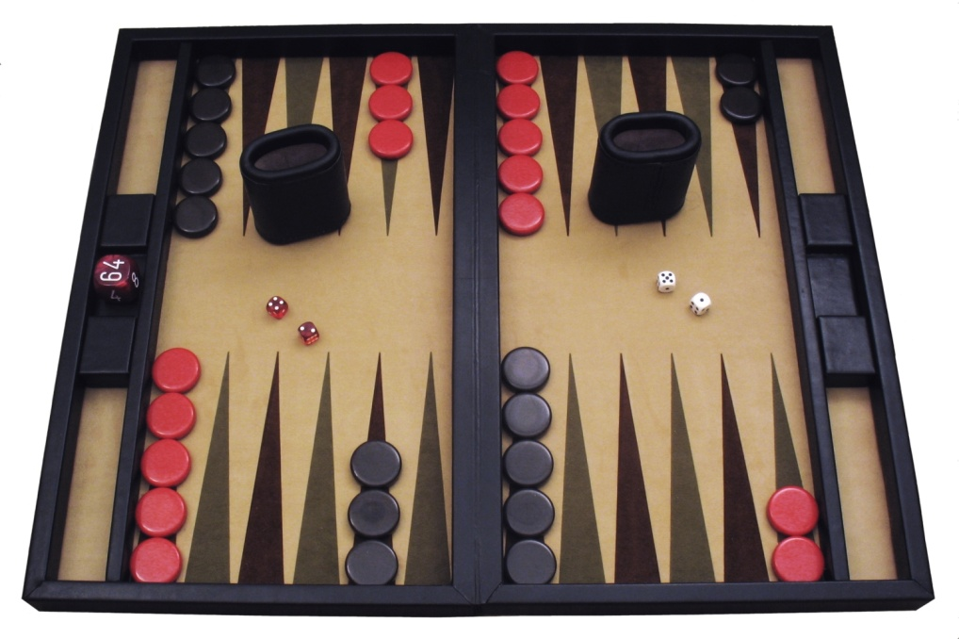
Example: Backgammon
Dice rolls increase b: 21 possible rolls with 2 dice
Backgammon ≈ 20 legal moves
Depth 2 = 20 x (21 x 20)³ = 1.2 x 10⁹
As depth increases, probability of reaching a given search node shrinks
So usefulness of search is diminished
So limiting depth is less damaging
But pruning is trickier…
Historic AI: TDGammon uses depth-2 search + very good evaluation function + reinforcement learning: world-champion level play
1st AI world champion in any game!
Image: Wikipedia

Slide 17
Mixed Layer Types
E.g. Backgammon
Expectiminimax
Environment is an extra “random agent” player that moves after each min/max agent
Each node computes the appropriate combination of its children
Max nodes
Chance nodes
Min nodes
Notes:
I move, you move. Each tie, we roll some dice. This is an expectimenimax tree.
If it’s terminal or we reached our depth limit, return utility.

Slide 18
Utilities
AIMA Chapter 16.1-16.3
Notes:
Everything in minimax and expectimax has referenced the notion of Utilties. The idea that there are values that you can go around either maximizing or minimizing or taking the average of.
What are these numbers? Where do they come from? How do we even know that they exist?

Slide 19
Maximum Expected Utility
Why should we average utilities? Why not minimax?
Principle of maximum expected utility:
A rational agent should chose the action that maximizes its expected utility, given its knowledge
Questions:
Where do utilities come from?
How do we know such utilities even exist?
How do we know that averaging even makes sense?
What if our behavior (preferences) can’t be described by utilities?
Notes:
If we have utilities, why should we ever average them?
The answer is vampire bunnies. Worst case reasoning only works if your model is able to assign very low probabilities to very bad events. You need probabilistic reasoning and averages.
This is going to lead us down the path of probabilistic reasoning.
Are humans so complex that they can’t be boiled down to these probabilities?

Slide 20
What Utilities to Use?
0
40
20
30
x²
0
1600
400
900
For worst-case minimax reasoning, terminal function scale doesn’t matter
We just want better states to have higher evaluations (get the ordering right)
We call this insensitivity to monotonic transformations
For average-case expectimax reasoning, we need magnitudes to be meaningful
Notes:
Minimax is really about the ordering of the states.
IN expectiax, the right tree would give me average of 20 and 25, so I would take the right branch. What about in the right tree? That would give me 800 and 650, so I would take the left branch.
The magnitudes are very important here.

Slide 21

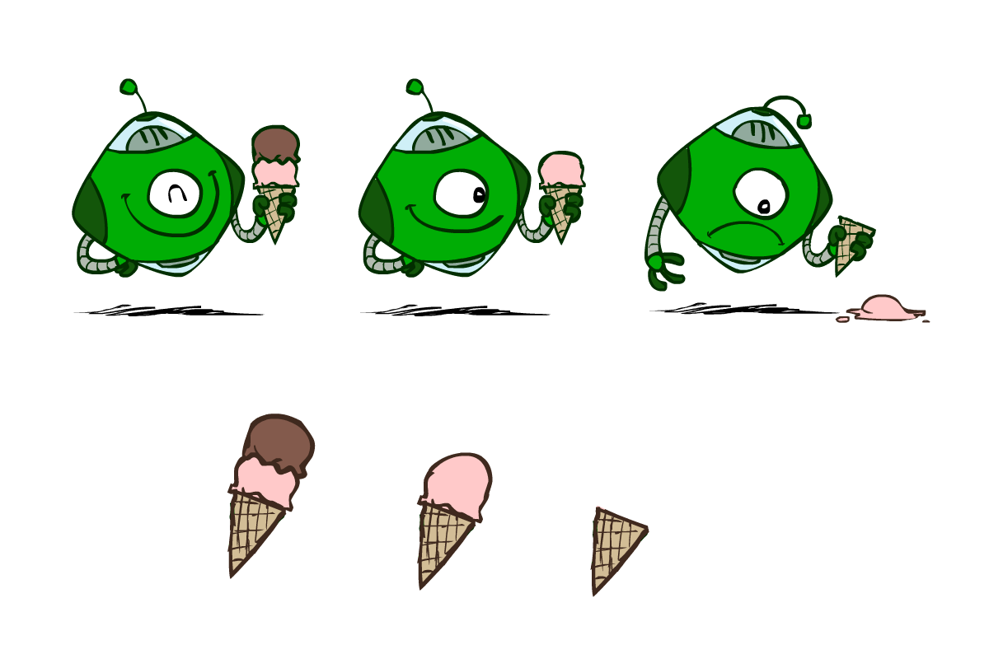
Utilities
Utilities are functions from outcomes (states of the world) to real numbers that describe an agent’s preferences
Where do utilities come from?
In a game, may be simple (+1/-1)
Utilities summarize the agent’s goals
Theorem: any “rational” preferences can be summarized as a utility function
We hard-wire utilities and let behaviors emerge
Why don’t we let agents pick utilities?
Why don’t we prescribe behaviors?

Slide 22

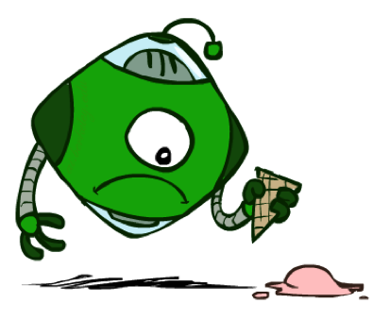

Utilities: Uncertain Outcomes
Getting ice cream
Get Single
Get Double
Oops
Whew!
Notes:
The robot has to choose not only between utilities, but also uncertain outcomes.

Slide 23
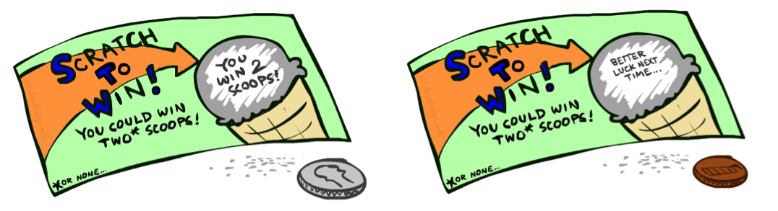
Preferences
A Prize
A Lottery
An agent must have preferences among:
Prizes: A, B, etc.
Lotteries: situations with uncertain prizes
Notation:
Preference:
Indifference:
A
p 1-p
A B
Notes:
A prize is a given outcome.
Lotteries are mixtures with probabilities attached.

Slide 24
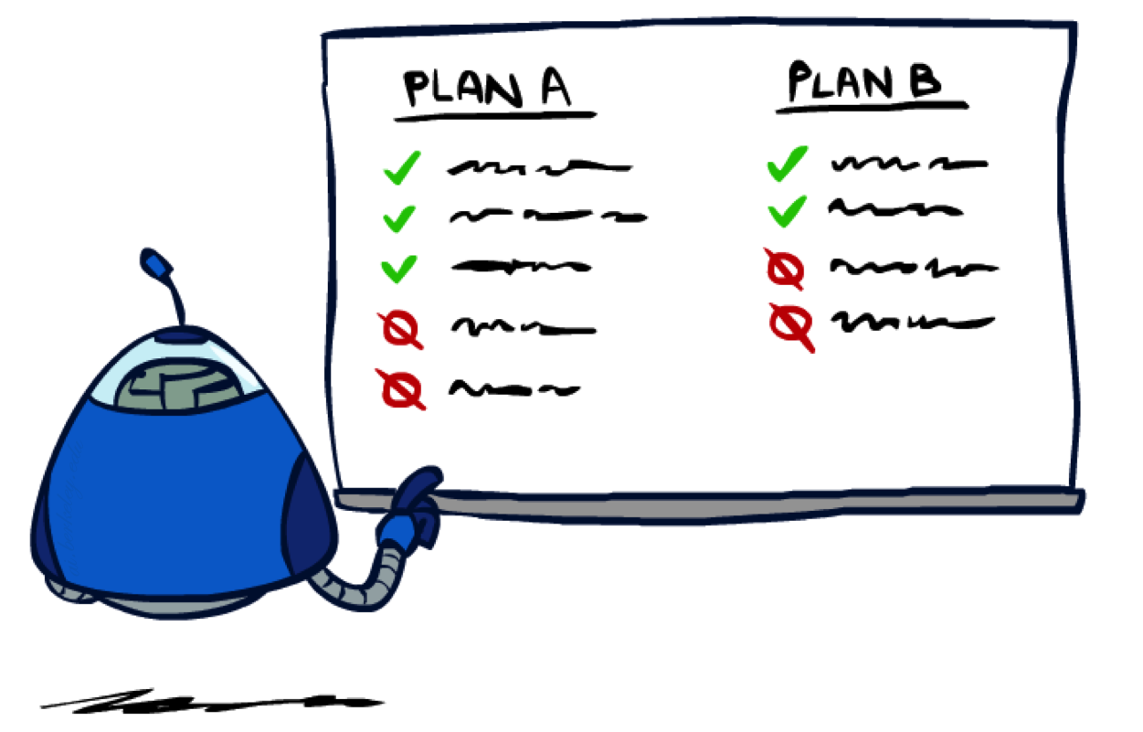
Rationality
Notes:
Are there good preferences and bad preferences? What do we need in order to decide is an agent is rational?

Slide 25
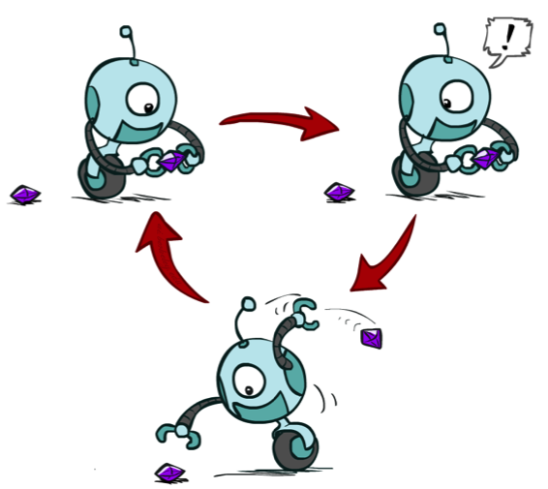
Rational Preferences
We want some constraints on preferences before we call them rational, such as:
For example: an agent with intransitive preferences can
be induced to give away all of its money
If B > C, then an agent with C would pay (say) 1 cent to get B
If A > B, then an agent with B would pay (say) 1 cent to get A
If C > A, then an agent with A would pay (say) 1 cent to get C
Axiom of Transitivity:
Notes:
Apple, banana, carrot
Some things don’t make sense.
... This is a defect in behavior.

Slide 26

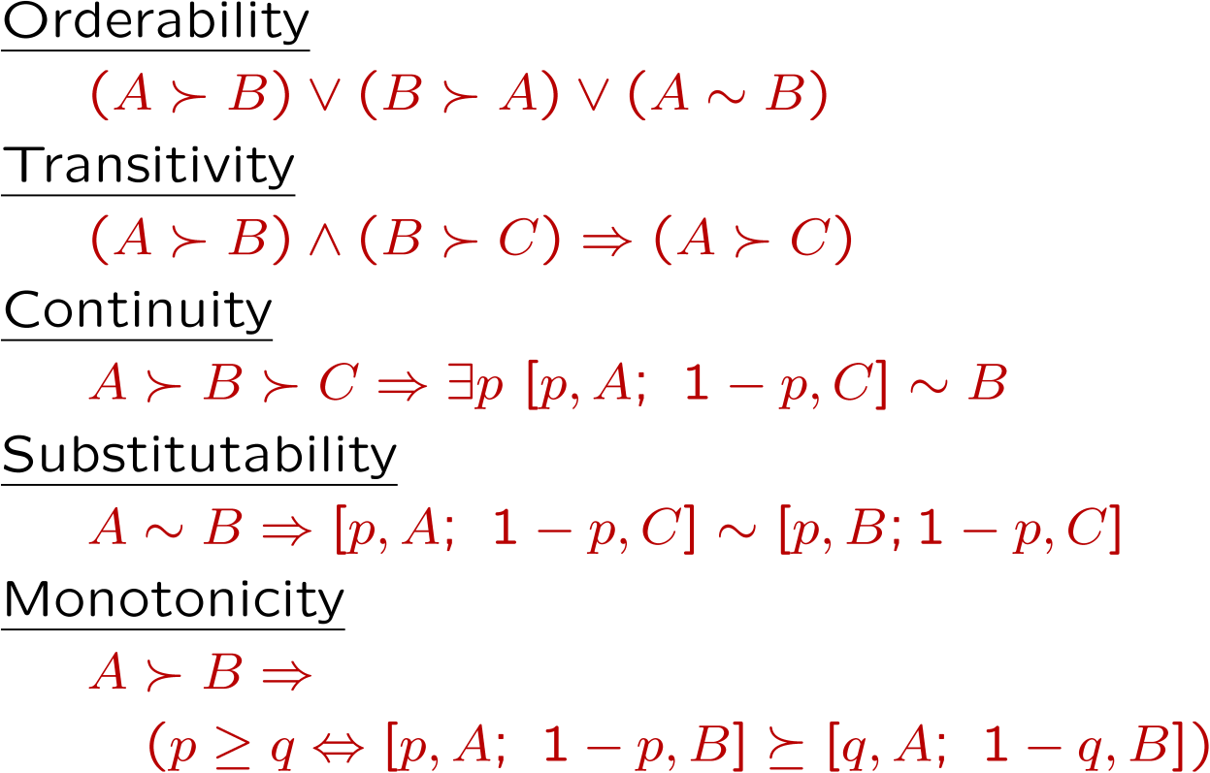
Rational Preferences
The Axioms of Rationality
Theorem: Rational preferences imply behavior describable as maximization of expected utility
Notes:
Orderability. You have to like A better or B better or be indifferent.
Transitivity, we just saw.
Continuity. More subtle. If you like A better than C and B is somewhere in the middle. Then there has to be some lottery between A and C, where you’re indifferent with B.
Substitutability. If they’re exchangeable on their own then they are exchangeable in a lottery.
Monotonicity. Also reasonable. If A is better than B, and you have a lottery between A and B, then you would prefer more A in the mix.
If you accept these actions, then rational preferences that obey these, then all of your behavior is describable by maximizing utilities.

Slide 27
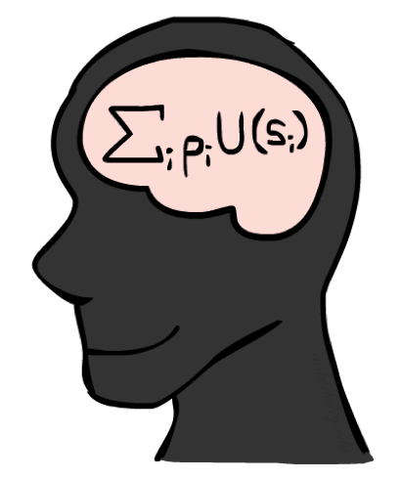
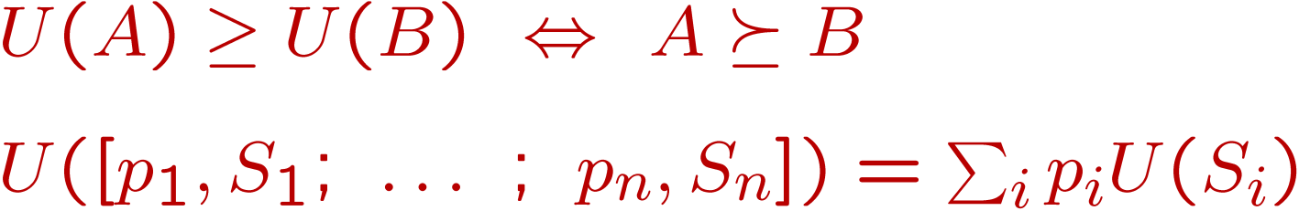
MEU Principle
Theorem [Ramsey, 1931; von Neumann & Morgenstern, 1944]
Given any preferences satisfying these constraints, there exists a real-valued
function U such that:
I.e. values assigned by U preserve preferences of both prizes and lotteries!
Maximum expected utility (MEU) principle:
Choose the action that maximizes expected utility
Note: an agent can be entirely rational (consistent with MEU) without ever representing or manipulating utilities and probabilities
E.g., a lookup table for perfect tic-tac-toe, a reflex vacuum cleaner
Notes:
Here’s the theorem.
There exists a real valued function U with the following properties.
U captures your ordinal preferences.
Utility of a lottery is the expectation of the elements of the lottery.
This means the utility captures your preference not only between prizes, but between lotteries!
It’s amazing! It means your utilities are preserved under expectation.
You want your BEHAVIORS to be consistent to the MEU Princple.

Slide 28
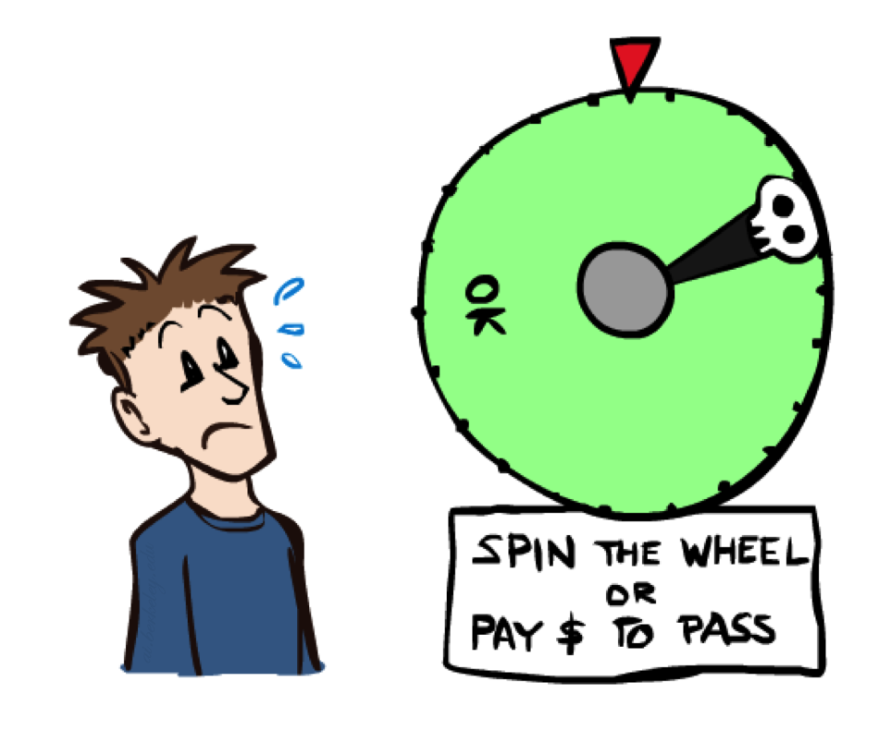
Human Utilities
Notes:
You can be represented with utilities! And MEU.

Slide 29

Utility Scales
Normalized utilities: u₊ = 1.0, u₋ = 0.0
Micromorts: one-millionth chance of death, useful for paying to reduce product risks, etc.
QALYs: quality-adjusted life years, useful for medical decisions involving substantial risk
Note: behavior is invariant under positive linear transformation
With deterministic prizes only (no lottery choices), only ordinal utility can be determined, i.e., total order on prizes
Notes:
These are kind of morbid. Reason about product recalls, where you’re talking about chance of death.
How do I actually get the real valued numbers that you assign to U?
I need to ask you questions about lotteries….

Slide 30


Human Utilities
Utilities map states to real numbers. Which numbers?
Standard approach to assessment (elicitation) of human utilities:
Compare a prize A to a standard lottery L_{p} between
“best possible prize” u₊ with probability p
“worst possible catastrophe” u₋ with probability 1-p
Adjust lottery probability p until indifference: A ~ L_{p}
Resulting p is a utility in [0,1]
Pay $30
0.999999 0.000001
No change
Instant death
Notes:
Elicit preferences.
Slide the value until the person becomes indifferent. That’s the way that I can assign a number to U.
How much do you NOT want to pay $30? No change is better than paying $30, instant death is worse.
Once I find that magical probability that makes you indifferent, then I know U.
If we made it worse, pay $3m be in debt forever.

Slide 31
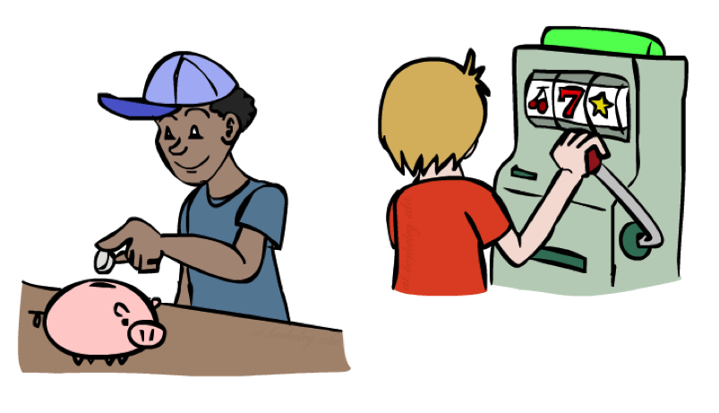
Money
Money does not behave as a utility function, but we can talk about the utility of having money (or being in debt)
Given a lottery L = [p, $X; (1-p), $Y]
The expected monetary value EMV(L) is p*X + (1-p)*Y
U(L) = p*U($X) + (1-p)*U($Y)
Typically, U(L) < U( EMV(L) )
In this sense, people are risk-averse
When deep in debt, people are risk-prone
Notes:
How about money? Can we use money as a utility scale? No! It’s not a good utility scale. We can talk about the utility of money, but it itself isn’t a good utility scale. Why not?
Imagine a lottery where you get X dollars or Y dollars.
Obviously, how good this is depends on X, Y and p.
Typically a utility of a lottery over money is worth less than its equivalent monetary value.
You’d rather have a smaller amount that is guaranteed.
How many of you would like a million dollars?
How many of you would like a billion dollars? How much more? 1000x more? Maybe not?
Let’s say I gave you a billion. Now how much do you want a million? Not much.
Diminishing returns. I’m told after your first billion, your second billion has less utility.
Same thing in the negative. Once you’re $1b in debt, whatever, you’re too big.

Slide 32
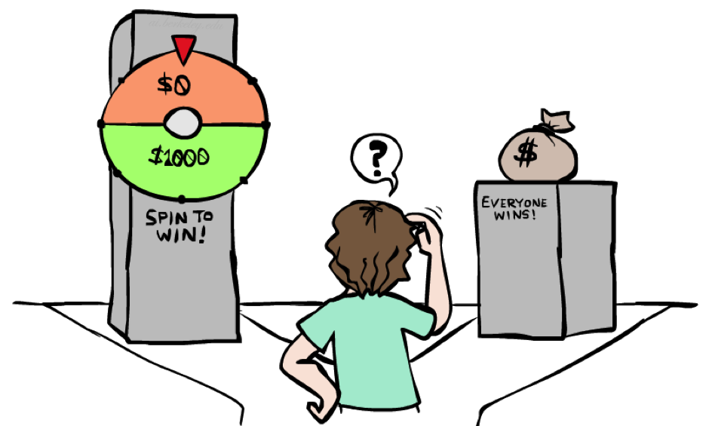
Example: Insurance
Consider the lottery [0.5, $1000; 0.5, $0]
What is its expected monetary value? ($500)
What is its certainty equivalent?
Monetary value acceptable in lieu of lottery
$400 for most people
Difference of $100 is the insurance premium
There’s an insurance industry because people will pay to reduce their risk
If everyone were risk-neutral, no insurance needed!
It’s win-win: you’d rather have the $400 and the insurance company would rather have the lottery (their utility curve is linear and they have many lotteries)
Notes:
Lottery example = $1000 computer, 50% chance that you’ll get it stolen, in which case you are left with $0.
Certainty equivalent. That’s how much money you would be willing to trade this lottery for. Trade uncertainty for certainty.
Certainty equivalent. How much would you trade this lottery for? How many would trade this for $10? How about $900? How about $400?
Because of these preferences there are things like insurance.
Is insurance just a scam? No, it’s win-win!

Slide 33

Example: Human Rationality?
Famous example of Allais (1953)
A: [0.8, $4k; 0.2, $0]
B: [1.0, $3k; 0.0, $0]
C: [0.2, $4k; 0.8, $0]
D: [0.25, $3k; 0.75, $0]
Most people prefer B > A, C > D
But if U($0) = 0, then
B > A ⇒ U($3k) > 0.8 U($4k)
C > D ⇒ 0.8 U($4k) > U($3k)
Notes:
Are humans perfectly rational? Here’s a classic experiment
B is the clear winner.
C is the winner.
Most people prefer C over D.
Multiply C and D by 4 and get the opposite conclusion 0.2*4 = 0.8, 0.25*4 = 1, so 0.8 U($4k) > 1.0 * U($3k)
So what the heck? You’re making irrational preferences? Are you irrational or did I do something wrong?
There’s a lot going on.
Prize B said 100% chance of 3k. 0 is actually important.
What do you get if you choose A, and you win $0? You get the feeling of stupidity.

Slide 34
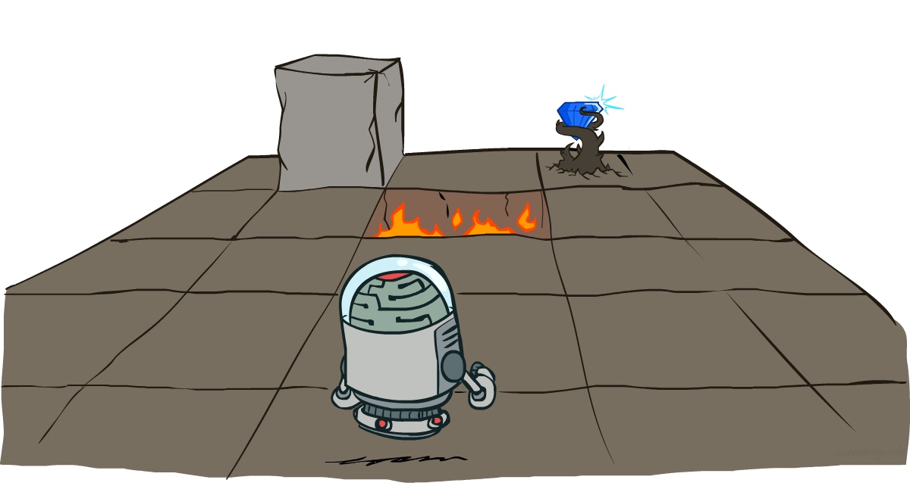
Markov Decision Processes
Slides courtesy of Dan Klein and Pieter Abbeel
University of California, Berkeley
[These slides were created by Dan Klein and Pieter Abbeel for CS188 Intro to AI at UC Berkeley. All CS188 materials are available at http://ai.berkeley.edu.]
Notes:
Please retain proper attribution, including the reference to ai.berkeley.edu. Thanks!

Slide 35
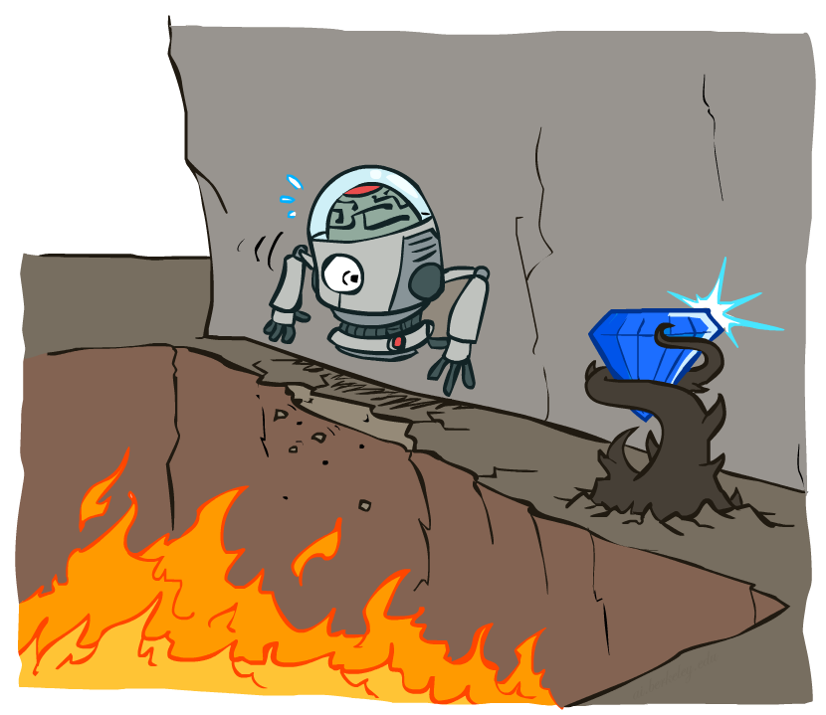
Non-Deterministic Search

Slide 36





Example: Grid World
A maze-like problem
The agent lives in a grid
Walls block the agent’s path
Noisy movement: actions do not always go as planned
80% of the time, the action North takes the agent North (if there is no wall there)
10% of the time, North takes the agent West; 10% East
If there is a wall in the direction the agent would have been taken, the agent stays put
The agent receives rewards each time step
Small “living” reward each step (can be negative)
Big rewards come at the end (good or bad)
Goal: maximize sum of rewards
Notes:
[cut demo of moving around in grid world program]

Slide 37
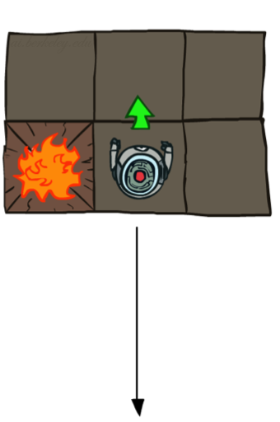
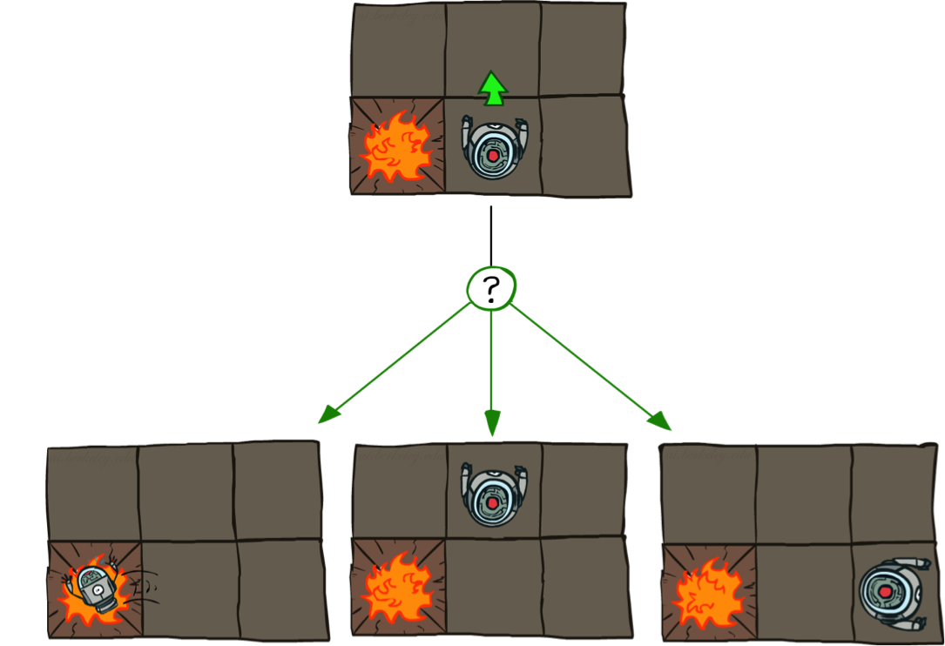

Grid World Actions
Deterministic Grid World
Stochastic Grid World

Slide 38
Markov Decision Processes
An MDP is defined by:
A set of states s ∈ S
A set of actions a ∈ A
A transition function T(s, a, s’)
Probability that a from s leads to s’, i.e., P(s’| s, a)
Also called the model or the dynamics
A reward function R(s, a, s’)
Sometimes just R(s) or R(s’)
A start state
Maybe a terminal state
MDPs are non-deterministic search problems
One way to solve them is with expectimax search
We’ll have a new tool soon
Notes:
In search problems: did not talk about actions, but about successor functions --- now the information inside the successor function is unpacked into actions, transitions and reward
Write out S, A, example entry in T, entry in R
Reward function different from the book : R(s,a,s’)
In book simpler for equations, but not useful for the projects.
Need to modify expectimax a tiny little bit to account for rewards along the way, but that’s something you should be able to do, and so you can already solve MDP’s (not in most efficient way)

Slide 39

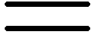
What is Markov about MDPs?
“Markov” generally means that given the present state, the future and the past are independent
For Markov decision processes, “Markov” means action outcomes depend only on the current state
This is just like search, where the successor function could only depend on the current state (not the history)
Andrey Markov (1856-1922)
Notes:
Like search: successor function only depended on current state
Can make this happen by stuffing more into the state;
Very similar to search problems: when solving a maze with food pellets, we stored which food pellets were eaten

Slide 40

Policies
In deterministic single-agent search problems, we wanted an optimal plan, or sequence of actions, from start to a goal
For MDPs, we want an optimal policy π*: S → A
A policy π gives an action for each state
An optimal policy is one that maximizes expected utility if followed
An explicit policy defines a reflex agent
Expectimax didn’t compute entire policies
It computed the action for a single state only
Optimal policy when R(s, a, s’) = -0.03 for all non-terminals s
Notes:
Dan has a DEMO for this.

Slide 41
Optimal Policies
R(s) = -0.01
R(s) = -0.03
R(s) = -0.4
R(s) = -2.0
Notes:
R(s) = the “living reward”

Slide 42
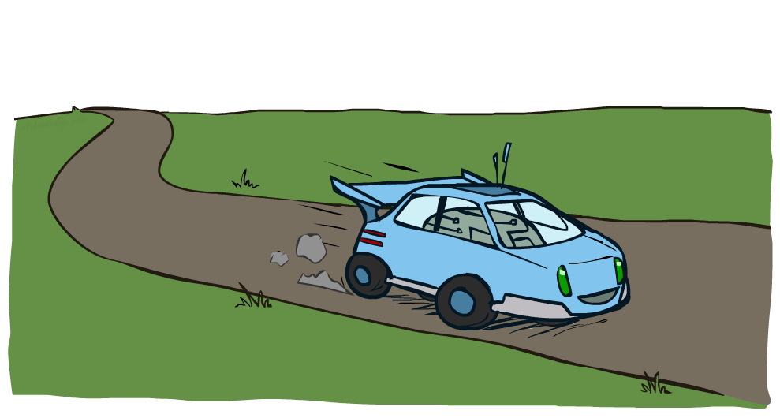
Example: Racing

Slide 43
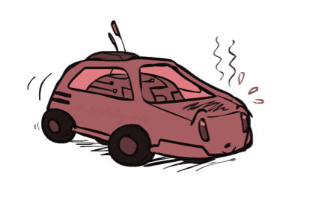
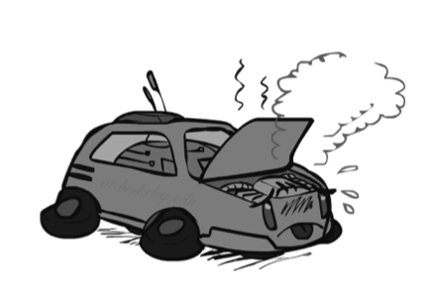
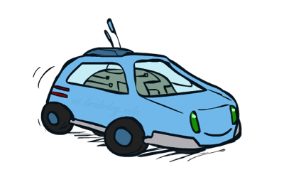
Example: Racing
A robot car wants to travel far, quickly
Three states: Cool, Warm, Overheated
Two actions: Slow, Fast
Going faster gets double reward
0.5
+1
1.0
Fast
Slow
-10
+1
0.5
Warm
Slow
Fast
0.5
+2
Cool
0.5
Overheated
+1
1.0
+2

Slide 44




Racing Search Tree

Slide 45


MDP Search Trees
Each MDP state projects an expectimax-like search tree
s
s is a state
a
(s, a) is a q-state
s, a
(s,a,s’) called a transition
T(s,a,s’) = P(s’|s,a)
R(s,a,s’)
s,a,s’
s’
Notes:
In MDP chance node represents uncertainty about what might happen based on (s,a) [as opposed to being a random adversary]
Q-state (s,a) is when you were in a state and have committed to take an action an action
Differences with expectimax tree: (1) Transition function encodes the probabilities. (2) Rewards are given on each state of the tree, rather than all the way on the bottom at the terminal nodes.

Slide 46
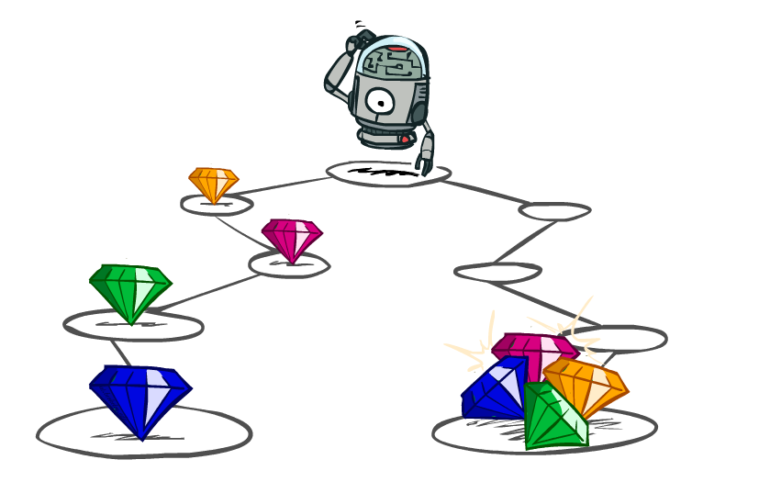
Utilities of Sequences
Notes:
In MDPs, rewards come to you step by step.
We need to decide what our reward function should be.
For example here, we might have a different way of rewarding this agent. One by giving the rewards incrementally, and one by giving them all at the end.

Slide 47
Utilities of Sequences
What preferences should an agent have over reward sequences?
More or less?
Now or later?
[1, 2, 2]
or
[2, 3, 4]
[0, 0, 1]
or
[1, 0, 0]

Slide 48




Discounting
It’s reasonable to maximize the sum of rewards
It’s also reasonable to prefer rewards now to rewards later
One solution: values of rewards decay exponentially
Worth Now
Worth Next Step
Worth In Two Steps
Notes:
Gamma

Slide 49

Discounting
How to discount?
Each time we descend a level, we multiply in the discount once
Why discount?
Sooner rewards probably do have higher utility than later rewards
Also helps our algorithms converge
Example: discount of 0.5
U([1,2,3]) = 1*1 + 0.5*2 + 0.25*3
U([1,2,3]) < U([3,2,1])
Notes:
Rewards in the future (deeper in the tree) matter less
Interesting: running expectimax, if having to truncate the search, then not losing much; e.g., less then \gamma^d / (1-\gamma)

Slide 50
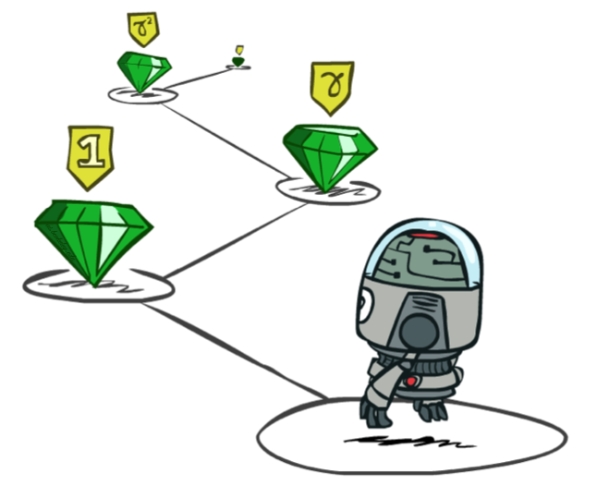
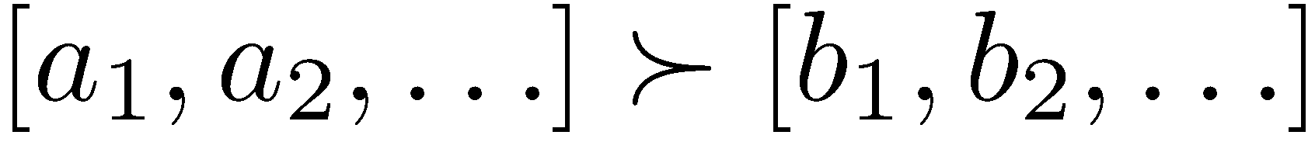
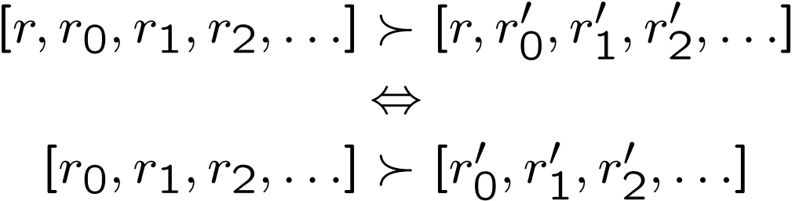
Stationary Preferences
Theorem: if we assume stationary preferences:
Then: there are only two ways to define utilities
Additive utility:
Discounted utility:
Notes:
R is a reward.
Actually only one way, since if gamma were 1, then the discounted utility would be the additive utility.

Slide 51
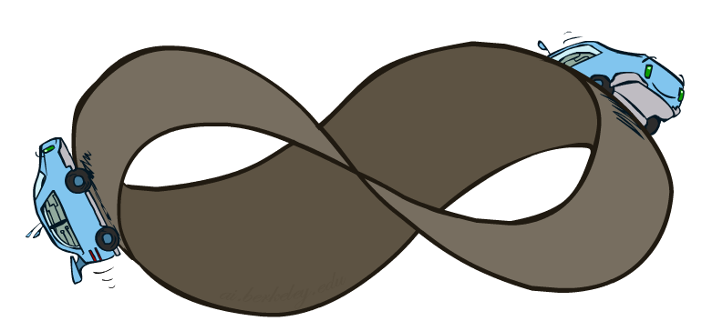
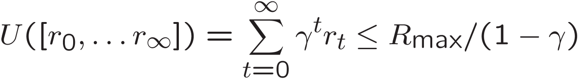
Infinite Utilities?!
Problem: What if the game lasts forever? Do we get infinite rewards?
Solutions:
Finite horizon: (similar to depth-limited search)
Terminate episodes after a fixed T steps (e.g. life)
Gives nonstationary policies (π depends on time left)
Discounting: use 0 < γ < 1
Smaller γ means smaller “horizon” – shorter term focus
Absorbing state: guarantee that for every policy, a terminal state will eventually be reached (like “overheated” for racing)

Slide 52
Recap: Defining MDPs
Markov decision processes:
Set of states S
Start state s₀
Set of actions A
Transitions P(s’|s,a) (or T(s,a,s’))
Rewards R(s,a,s’) (and discount γ)
MDP quantities so far:
Policy = Choice of action for each state
Utility = sum of (discounted) rewards
s
a
s, a
s,a,s’
s’

Slide 53
Solving MDPs

Slide 54
Optimal Quantities
The value (utility) of a state s:
V*(s) = expected utility starting in s and acting optimally
The value (utility) of a q-state (s,a):
Q*(s,a) = expected utility starting out having taken action a from state s and (thereafter) acting optimally
The optimal policy:
π*(s) = optimal action from state s
s
s is a state
a
(s, a) is a q-state
s, a
s,a,s’
(s,a,s’) is a transition
s’
Notes:
Pi is a policy. Pi* is the optimal policy from state s.

Slide 55


Values of States
Fundamental operation: compute the (expectimax) value of a state
Expected utility under optimal action
Average sum of (discounted) rewards
This is just what expectimax computed!
Recursive definition of value:
s
a
s, a
s,a,s’
s’
Notes:
Max over chance nodes. That’s really just what expectimax was doing.
What do I do at a chance node Q(s,a).?
I’m going to get a reward. R(s,a,s’). Plus I’m going to get all the future rewards from this state V*(s’).
Both of course, I don’t know what’s going to happen at the chance node, so I need to sum over all states s’
We’re going to weight these by the relative probability that comes from our probability function. We write that T(s,a,s’).
We’re missing one thing. The discount of the future value. So we multiply that by Gamma.
This may look complicated, but you’re going to see this many times in the future. Don’t go into math shock. You can understand this.
We can also write this in one step. We write the expectimax recurrenece.
This is called a Bellman equation. We’re going to come back to this a lot starting in the next lecture.

Slide 56
Racing Search Tree

Slide 57


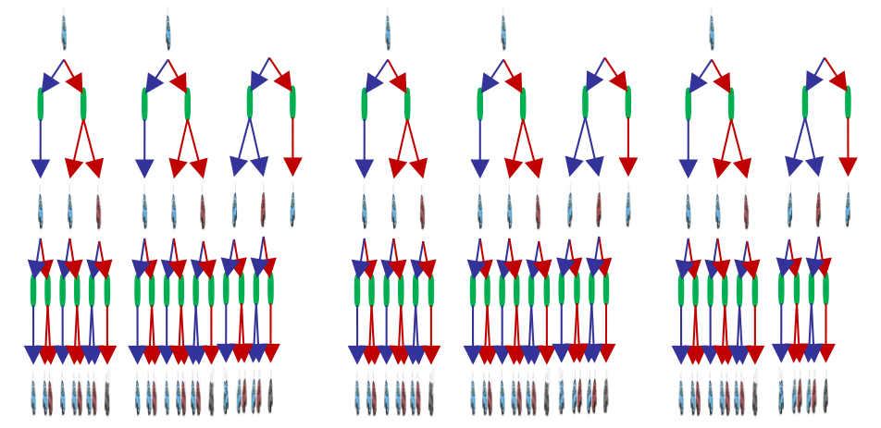
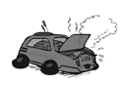
Racing Search Tree
Notes:
The tree gets very big very quickly. But I might think that expectimax is a colossal waste of time for this problem.

Slide 58
Racing Search Tree
We’re doing way too much work with expectimax!
Problem: States are repeated
Idea: Only compute needed quantities once
Problem: Tree goes on forever
Idea: Do a depth-limited computation, but with increasing depths until change is small
Note: deep parts of the tree eventually don’t matter if γ < 1
Notes:
At depth 100, then you have gamma to the 100. So it’s not going to contribute much at all.

Slide 59


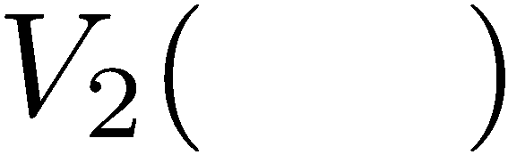

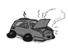
Time-Limited Values
Key idea: time-limited values
Define V_{k}(s) to be the optimal value of s if the game ends in k more time steps
Equivalently, it’s what a depth-k expectimax would give from s
Notes:
V_k is a time limited definition of V(s)

Slide 60
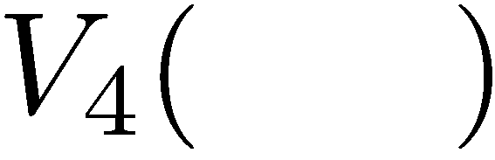

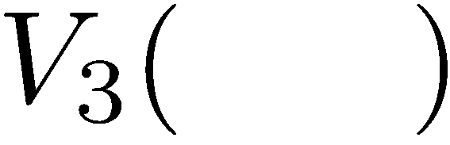
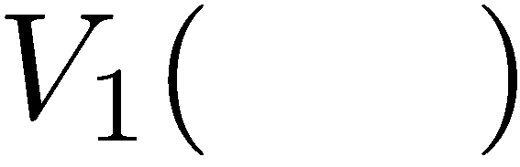
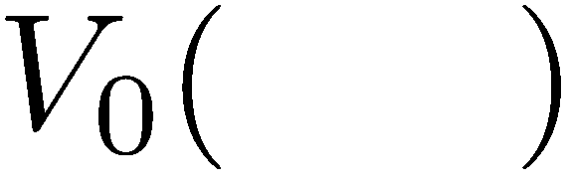
Computing Time-Limited Values
Notes:
V0, we know what it is it’s 0 for any state.
V1, is a depth 1 expectimax computation.
Each layer is a V_k for an increasing value of k.

Slide 61
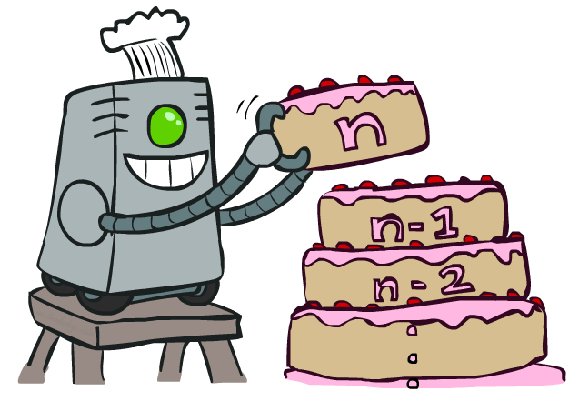
Value Iteration
Notes:
That’s an algorithm called value iteration. You can think of this as building your value from the bottom up. It will behave similarly to expectimax, but will be a lot less work, when we only have a small number of states. Let’s see how it works.

Slide 62
Value Iteration
Start with V₀(s) = 0: no time steps left means an expected reward sum of zero
Given vector of V_{k}(s) values, do one ply of expectimax from each state:
Repeat until convergence
Complexity of each iteration: O(S²A)
Theorem: will converge to unique optimal values
Basic idea: approximations get refined towards optimal values
Policy may converge long before values do
V_{k+1}(s)
a
s, a
s,a,s’
V_{k}(s’)
Notes:
We are going to store all of the V values in a vector. For V_0, everything is just 0.
The recursion is into an Expectimax tree that we have already compted. The recursion won’t actually happen because we’ve already got it.
What will this do, we can go from 0, to 1 to 2, to K. Each time we will go deeper into the tree. When should we stop? When the values start to converge.
Complexity = we do this update for each state, then we do a little expectimax. We do a for loop over A to take take a max over each action, then we do another for loop that goes over each state again.

Slide 63

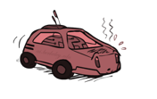
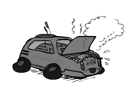
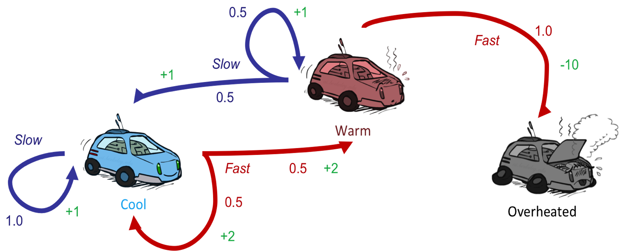
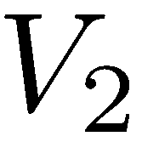
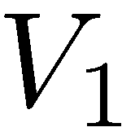
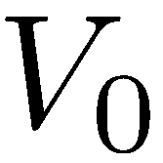
Example: Value Iteration
Assume no discount!
Notes:
V0 = 0 , 0 , 0
For V1.
On we’re going to do a little expectimax search for each value. As an equation that’s the V_k+1 ….
Let’s start with the cool state. But let’s think about it in terms of actions. What should I do. If I go slow, then I get +1, if I go fast then I get +2.
Now with the fast state, if I go slow then I get +1, if I go fast then I get -10. so max value is 1.
For V2,
Cool:
SLOW If I go slow then what do I get? I get 1, and if there’s no discount, then I’m going to land back at cool, so 2 is the Vk-1. Total is 2.
FAST If I go fast, then I’ve got a 2 instantaneously then I have a 50%/50% chance of plugging in 2 because I got sent back to cool, and plugging in 1 if I go to 1. Total = 3.5
So for cool, the max works out to 3.5
If I work that out for the warm state, then that comes out to 2.5.
As I go further up, then the numbers go up. That makes sense because I’m accumulating rewards at each step.
From this we can work out an optimal policy (when you’re cool go fast when you’re warm go slow).

Slide 64
Example: Value Iteration
3.5 2.5 0
2 1 0
Assume no discount!
0 0 0
Notes:
V0 = 0 , 0 , 0
For V1.
On we’re going to do a little expectimax search for each value. As an equation that’s the V_k+1 ….
Let’s start with the cool state. But let’s think about it in terms of actions. What should I do. If I go slow, then I get +1, if I go fast then I get +2.
Now with the fast state, if I go slow then I get +1, if I go fast then I get -10. so max value is 1.
For V2,
Cool:
SLOW If I go slow then what do I get? I get 1, and if there’s no discount, then I’m going to land back at cool, so 2 is the Vk-1. Total is 2.
FAST If I go fast, then I’ve got a 2 instantaneously then I have a 50%/50% chance of plugging in 2 because I got sent back to cool, and plugging in 1 if I go to 1. Total = 3.5
So for cool, the max works out to 3.5
If I work that out for the warm state, then that comes out to 2.5.
As I go further up, then the numbers go up. That makes sense because I’m accumulating rewards at each step.
From this we can work out an optimal policy (when you’re cool go fast when you’re warm go slow).

Slide 65
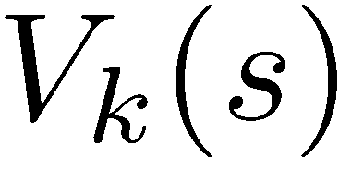
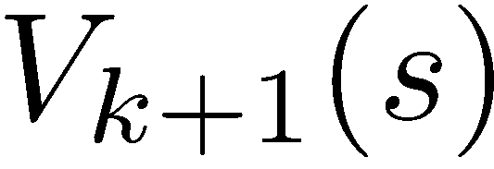
Convergence*
How do we know the V_{k} vectors are going to converge?
Case 1: If the tree has maximum depth M, then V_{M} holds the actual untruncated values
Case 2: If the discount is less than 1
Sketch: For any state V_{k} and V_{k+1} can be viewed as depth k+1 expectimax results in nearly identical search trees
The difference is that on the bottom layer, V_{k+1} has actual rewards while V_{k} has zeros
That last layer is at best all R_{MAX}
It is at worst R_{MIN}
But everything is discounted by γ^{k} that far out
So V_{k} and V_{k+1} are at most γ^{k} max|R| different
So as k increases, the values converge
Notes:
If the game is infinite, like in racing then it won’t converge.
Imagine tree V_k is actually depth V_k+1, but the last layer is all 0.
Draw height as k+1. Fill in bottom as 0.
…
How fast it converges, depends on the effective depth, or gamma. As gamma gets closer to 1, then the effective depth is deeper.

Slide 66
Next Time: Policy-Based Methods
Notes:
Since polices converged faster than the values did, then there might be a way to search over policies rather than over values.

